Slide 1
原子核的形状、集体激发与裂变 Nuclear shapes, collective excitation and fission
李志攀
西南大学物理科学与技术学院

Slide 2
提
纲
引言
微观集体哈密顿量模型
原子核形状共存、八极形
变与裂变
总结与展望

Slide 3
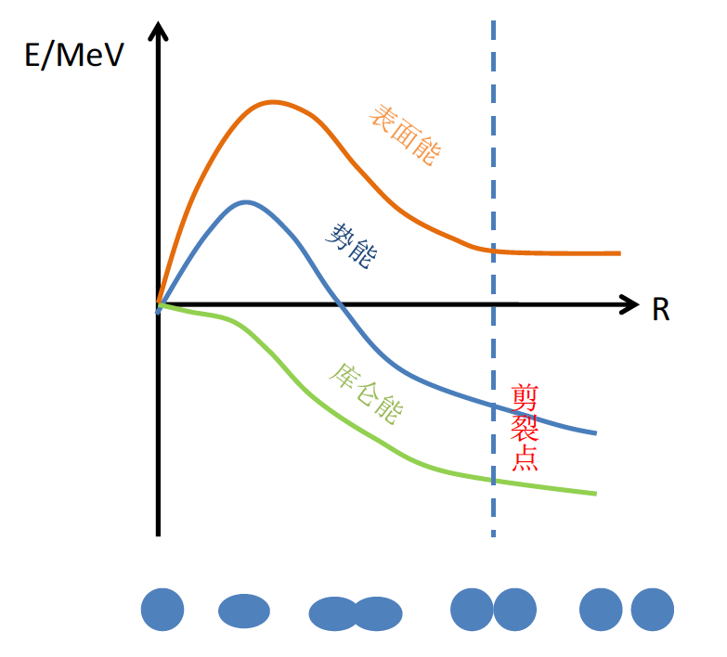

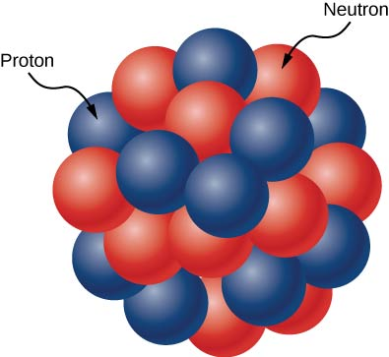
原子核的形状
用途广泛的核物理
人们对原子核形状的认知最早可追溯到液滴模型
20世纪30, 40年代
核力饱和特性
elongation
液滴
Meitner & Frisch, Nature 143, 239 (1939).
N. Bohr & Wheeler, Phys. Rev. 56, 426 (1939).
……
Notes:
人们对原子核形状的认知最早可追溯到液滴模型，
尤其是核裂变的发现改变了世界，同时极大推动了原子核液滴模型的发展

Slide 4
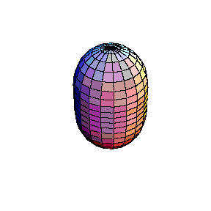

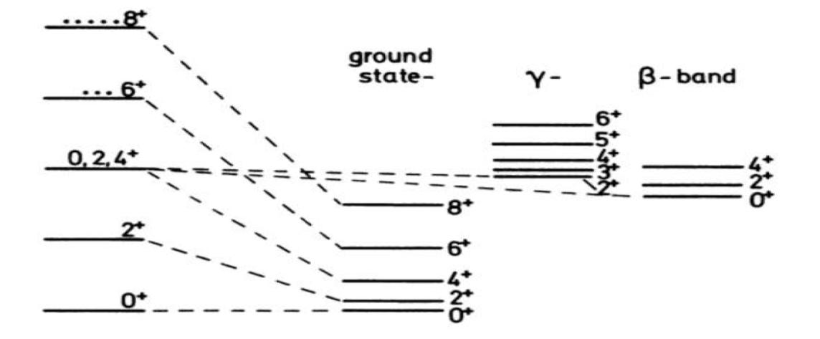
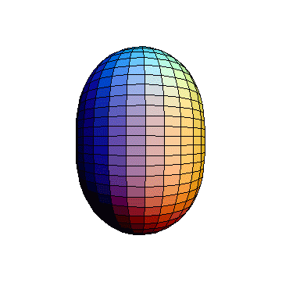
原子核的形状
用途广泛的核物理
20世纪50年代，四极集体振动与转动，Bohr集体模型
模型取得巨大成功，因此他们荣获了1975年诺贝尔物理学奖
A. Bohr, Mat. Fys. Medd. K. Dan. Vidensk Selsk. 26, 14 (1952).
A. Bohr & Mottelson, Mat. Fys. Medd. K. Dan. Vidensk Selsk. 27, 16 (1953).
Notes:
尤其是核裂变的发现改变了世界，同时极大推动了原子核液滴模型的发展

Slide 5

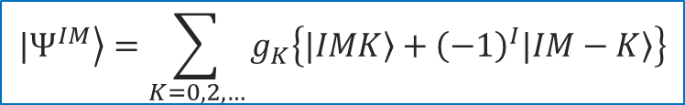
原子核的形状
用途广泛的核物理
20世纪50, 60年代，Davydov三轴转子
加速器与探测器不断升级:复杂低能激发谱与形状
形状共存
八极形变
超形变
对振动激发（与集体形状耦合）
……
$$\left.{|Ψ}^{IM}\right\rangle =\sum_{K=0,2,…}{g_{K}\left\{|\left.IMK\right\rangle +{\left(−1\right)}^{I}|\left.IM−K\right\rangle \right\}}$$
Davydov and Filippov, Nucl. Phys. 8, 237 (1958).

Slide 6








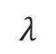
原子核的形状
$β_{λμ}$: deformation parameter
$$λ$$
Courtesy of B.N. Lv
Notes:
OK, our topic is nuclear shapes and collective motion. In general, we describe the intrinsic nuclear shapes using this expension. R is the radius which is depends on the angles. R_0 is the equavelent radius as a sphere. Beta_lambda\mu are the deformation parameters for different multipole expansions. Ylu are the spherical harmonic functions.
The following are the main focused shapes, the sphere, like a orange; prolate, like a watermelon; oblate, like a pumpkin; triaxial, like a kiwi; reflection-asymmetric octupole shape, like a pear; triaxial octupole, the so-called tetrahedron, like a tridational chinese food, Zongzi. Very large quadrupole deforamtion, like a gourd.

Slide 7
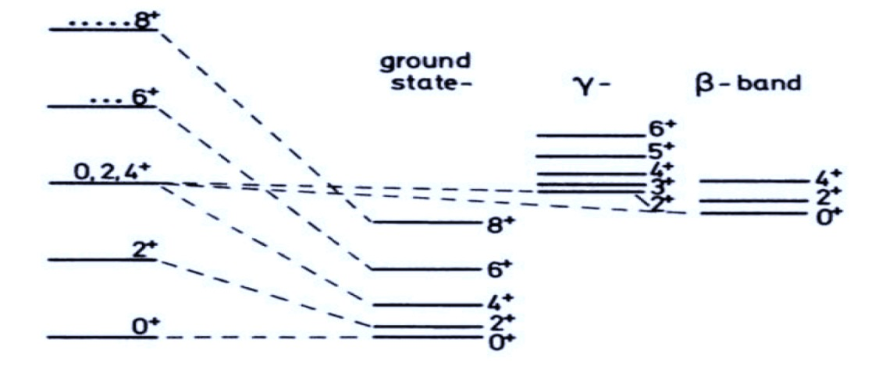
原子核集体运动
vibration, rotation …
Notes:
These shapes are generally not static, the system will do collective motions around their equilibrium shape, like the vibration, rotation and also the coupling between them. These will be reflected in the positive-parity low-lying spectrum.

Slide 8
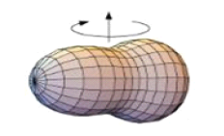
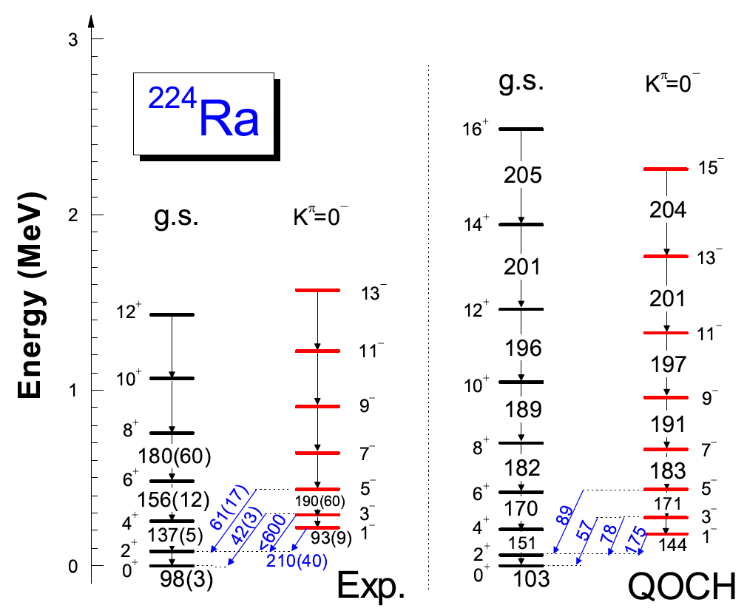
原子核集体运动
vibration, rotation …
Notes:
Vib & rot are also observed in octupole deformed nuclei and low-lying negative parity band appears in the system.

Slide 9
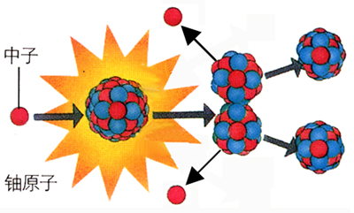
原子核集体运动
Nuclear fission
Neutron
Notes:
The very large elongation of heavy nuclei is highly related to the nuclear fission, which is always the frontier of nuclear physics from its discovery.

Slide 10
原子核形状与集体运动
Nuclear shapes
Shape phase transition
Shape coexistence
Super deformation
Isomer
Nuclear fission
Nuclear fusion
Notes:
Here, I summarize the very interesting topics related to nuclear shapes and collective motion, such as QPT, …

Slide 11
微观核模型
Notes:
当前主要使用的微观核模型有：从头计算方法；相互作用壳模型；密度泛函等，这里给出了几种模型主要的使用区域。我们关注的低能区集体运动主要发生在中重核区，因此密度泛函理论会是一个比较合适的出发点。

Slide 12


协变密度泛函理论(CDFT)
Success
Limitation of MF
Nuclear structure over almost the whole nuclide chart
Mean-field approximation: intrinsic ground state, deformation, PES
Spin-orbit splitting
Time-odd component
Origin of the pseudo-spin symmetry
……
Ring96, Vretenar05, Meng06, Meng16
Notes:
To describe nuclear shapes and large amplitude collective motion microscopically, the CDFT will be a good start point.
It has achieved great success in the description of nuclear structure over almost the whole nuclide chart due to the following advantages, such the natural inclusion of so splitting, time-odd component, origin of the pseudo-spin symmetry and so on.
In general, the mean-field approximation is used, and we can obtain the intrinsic g.s. ….
However, in the mf approximation, the system is fixed in the intrinsic frame, and it cannot describe the collective motion.

Slide 13
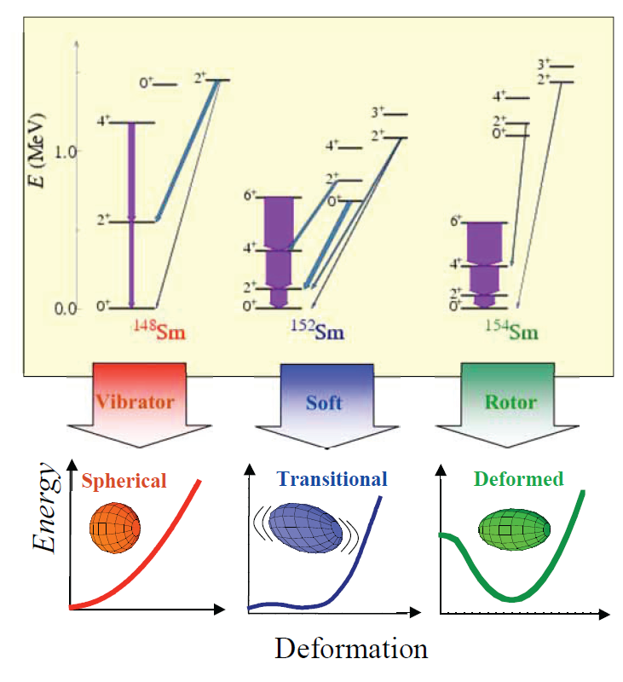
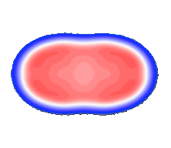
超越平均场方法
Vibration, rotation and related low-lying spectrum: beyond the mean-field approximation
Restoration of broken symmetry, e.g. rotational, parity
Mixing of different shape configurations
PES
Nuclear dynamics (slow): time evolution
(Time-dependent) Collective Hamiltonian based on CDFT
Decouple
Time: ~10⁻²²s
Time: ~10⁻¹⁹s
Notes:
To describe the collective motion, especially the related low-lying spectrum, one has to go beyond the mean-field approximation:
Namely, to restore the broken symmetry, particularly the rotational symmetry,
and mix the different shape configurations, especially for the transitional nuclei with the soft potential.
For nuclear dynamics, such as fission, we need to include the time evolution.
In general, the time scale for s.p. motion in the nucleus is ~10^-22 s and the collective motion is much slower, say 10^-20s. We can treat them in a decouple scheme. And thus we can construct a Hamiltonian in a collective space based on the microscopic CDFT.

Slide 14
提
纲
引言
微观集体哈密顿量模型
原子核形状共存、八极形
变与裂变
总结与展望

Slide 15

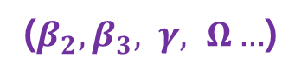
微观集体哈密顿量模型
Th.
Exp.
Collective Hamiltonian
Construct
Solve
Collective parameters
($β_{2},β_{3}, γ, Ω…$)
CDFT
ZPLi et al., PRC79, 054301 (2009)
Xia, Tao, Lu, ZPLi et al., PRC96, 054303 (2017)
Tao, Zhao, ZPLi et al., PRC96, 024319 (2017)
ZPLi and Vretenar, “Model for collective motion” in Handbook of nuclear physics
1
2
3
Notes:
We start from the covariant energy density functional, and specifically the point-coupling version of it. The energy functional has this form, which is expressed as a functional of densities, currents, and the derivations of them.
Then the collective parameters can be calculated by the cranking approximation.

Slide 16
微观集体哈密顿量模型
The CDFT (point-coupling version)
Burvenich02, Niksic08, PWZhao10, Meng2016
Relativistic Hartree-Bogoliubov Equation
Pairing field:
1
2
3
Notes:
We start from the covariant energy density functional, and specifically the point-coupling version of it. The energy functional has this form, which is expressed as a functional of densities, currents, and the derivations of them.
Then the collective parameters can be calculated by the cranking approximation.

Slide 17
微观集体哈密顿量模型
Solve in 3DHO basis
E_{tot} total E
|k> s.p. wf
ε_{k} s.p. energy
v_{k}² occupation
1
2
3
Notes:
We start from the covariant energy density functional, and specifically the point-coupling version of it. The energy functional has this form, which is expressed as a functional of densities, currents, and the derivations of them.
Then the collective parameters can be calculated by the cranking approximation.

Slide 18
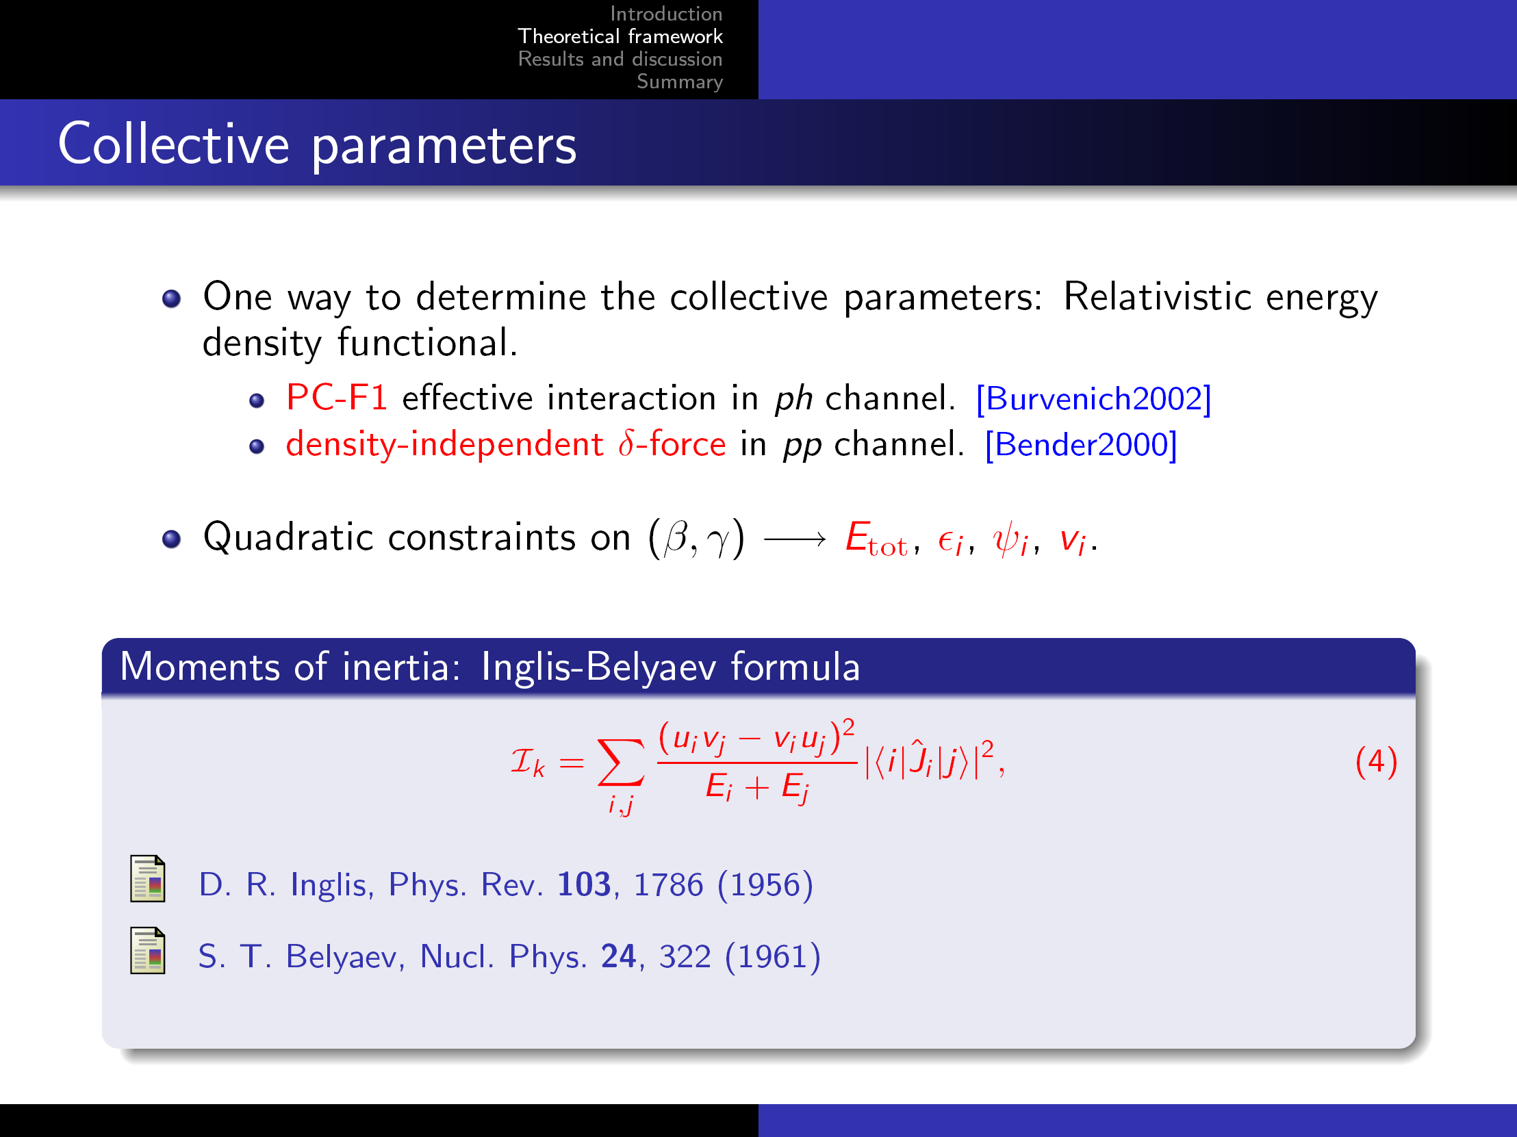
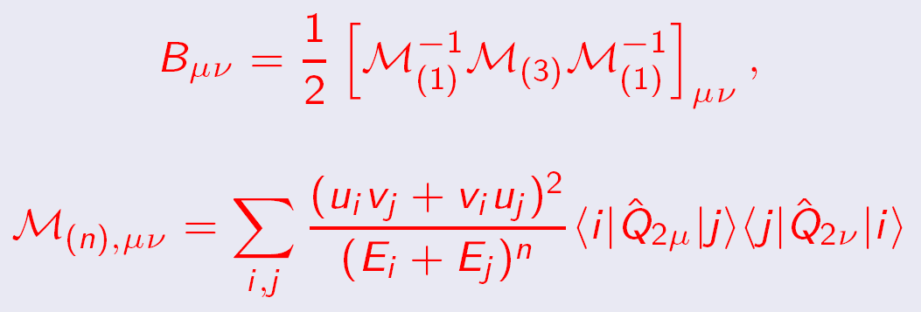
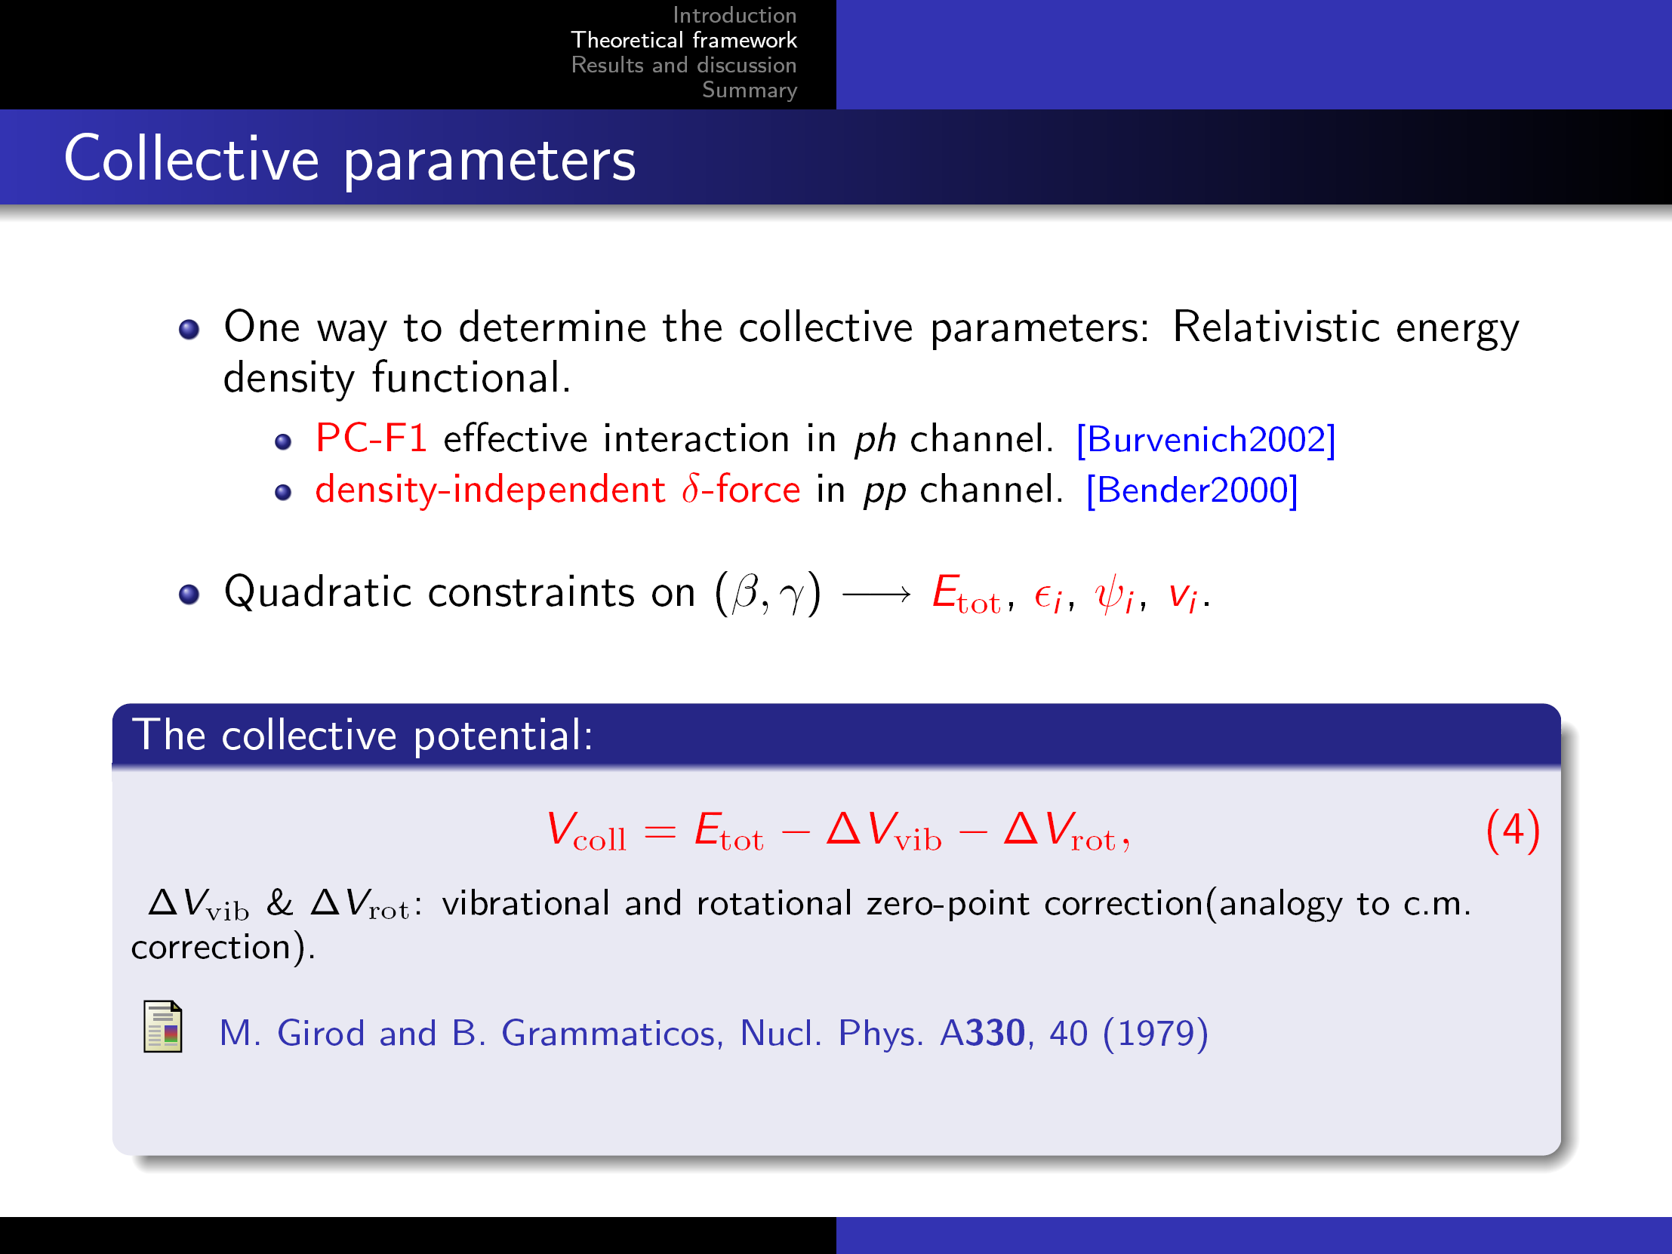


微观集体哈密顿量模型
The collective parameters
…………………………
$$T_{\text{rot}}=\frac{1}{2}Iω^{2}$$
…………………………
$$T_{\text{vib}}=\frac{1}{2}M{\dot{q}}^{2}$$
………..…
Vib. & Rot. correction，similar as E_{c.m.}
ZPLi et al., PRC79, 054301 (2009)
1
2
3
Notes:
We start from the covariant energy density functional, and specifically the point-coupling version of it. The energy functional has this form, which is expressed as a functional of densities, currents, and the derivations of them.
Then the collective parameters can be calculated by the cranking approximation.

Slide 19
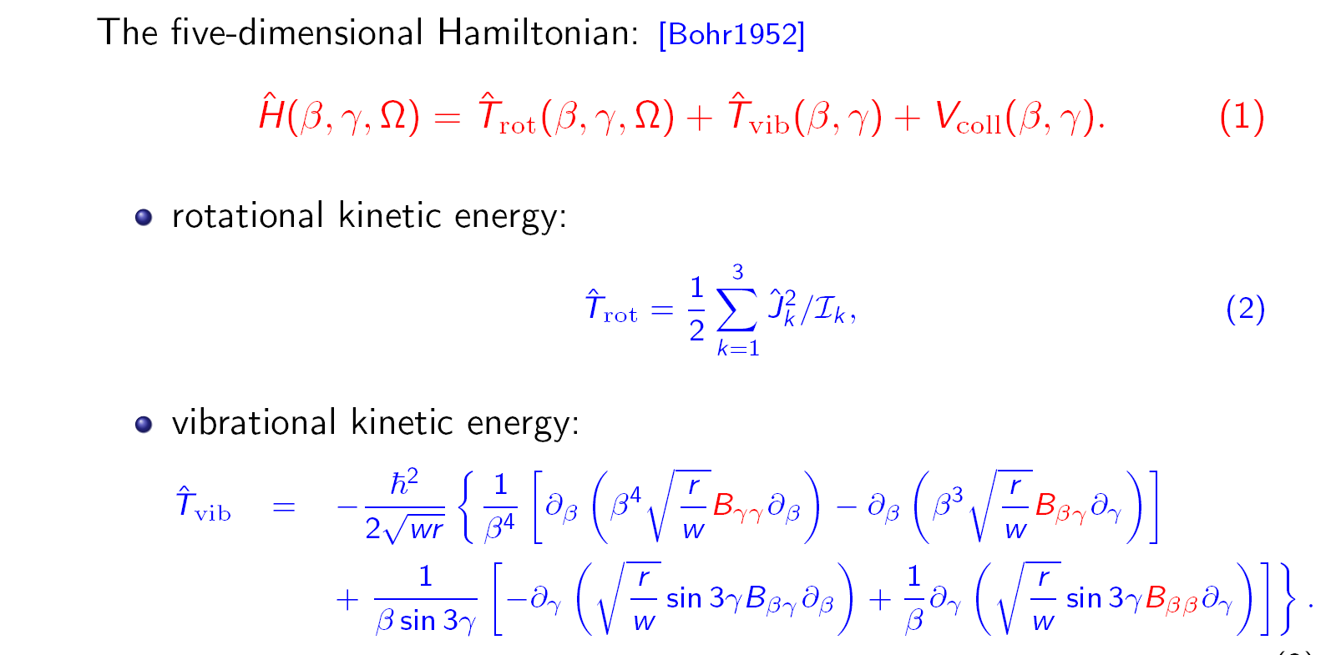
微观集体哈密顿量模型
1
2
3
Notes:
The collective Hamiltonian includes three parts: rotational and vibrational kinetic energy, and the collective potential.
The expression are shown as follows, in which the 7 collective parameters are determined by CDFT calculation as shown in previous slide. The dynamics of CH is fully determined by these 7 coll. parameters, and therefore by the microscopic calculation.

Slide 20
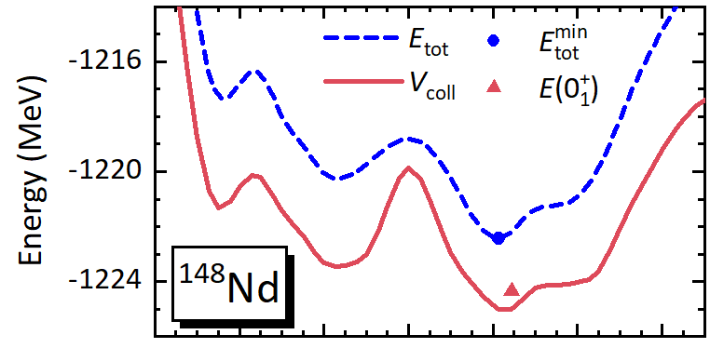
微观集体哈密顿量模型
DCE: dynamical correlation energy
DCE = 1.91 MeV
1
2
3
Notes:
Diagonalize the CH in a coll. Basis, we can obtain the low-lying spectrum. Here is one example for 154Gd. The coll. Potential in beta-gamma plane and obtained spectrum, g.s band, beta band and gamma band, which are in very good agreement with the data.

Slide 21
微观集体哈密顿量模型
CH
1
2
3
Notes:
Diagonalize the CH in a coll. Basis, we can obtain the low-lying spectrum. Here is one example for 154Gd. The coll. Potential in beta-gamma plane and obtained spectrum, g.s band, beta band and gamma band, which are in very good agreement with the data.

Slide 22
提
纲
引言
微观集体哈密顿量模型
原子核形状共存、八极形
变与裂变
总结与展望

Slide 23
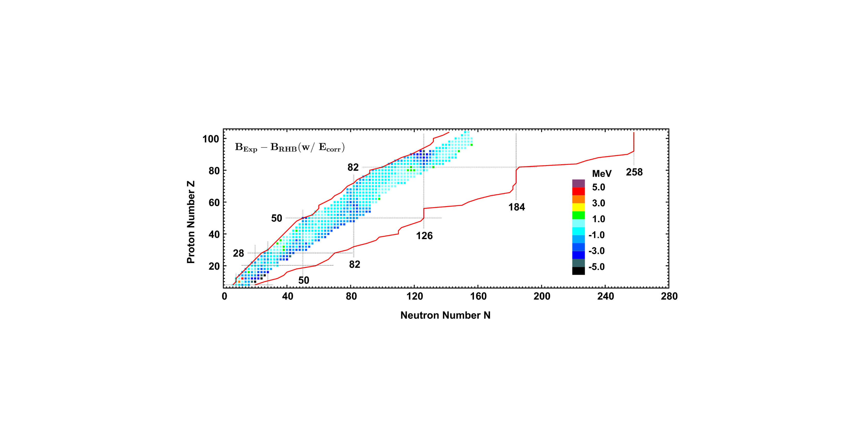
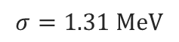
原子核结合能
$$σ=1.31 MeV$$
Experimental data from AME2016
With DCEs, the deviations of binding energies predicted by triaxial RHB with PC-PK1 are mostly within ±1 MeV. This is consistent with our previous triaxial RMF+BCS calculations.
K.Q. Lu, Z.X. Li, Z.P. Li, J.M. Yao, and J. Meng, Phys. Rev. C 91, 027304 (2015)
The RHB theory is more suitable for description of weakly bound neutron-rich nuclei, predicting a total of 2016 bound even-even nuclei with $8≤Z≤104$.

Slide 24
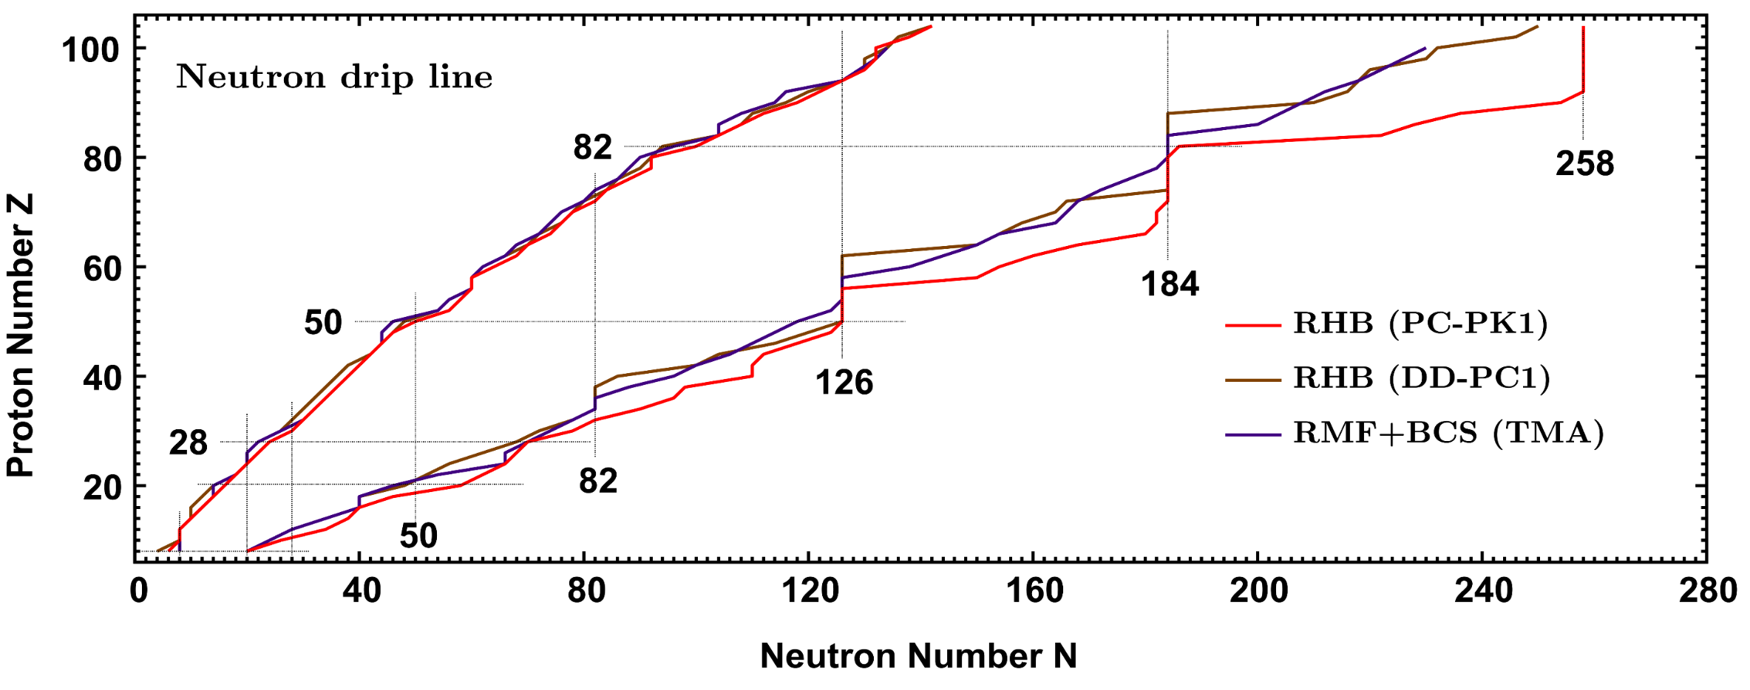
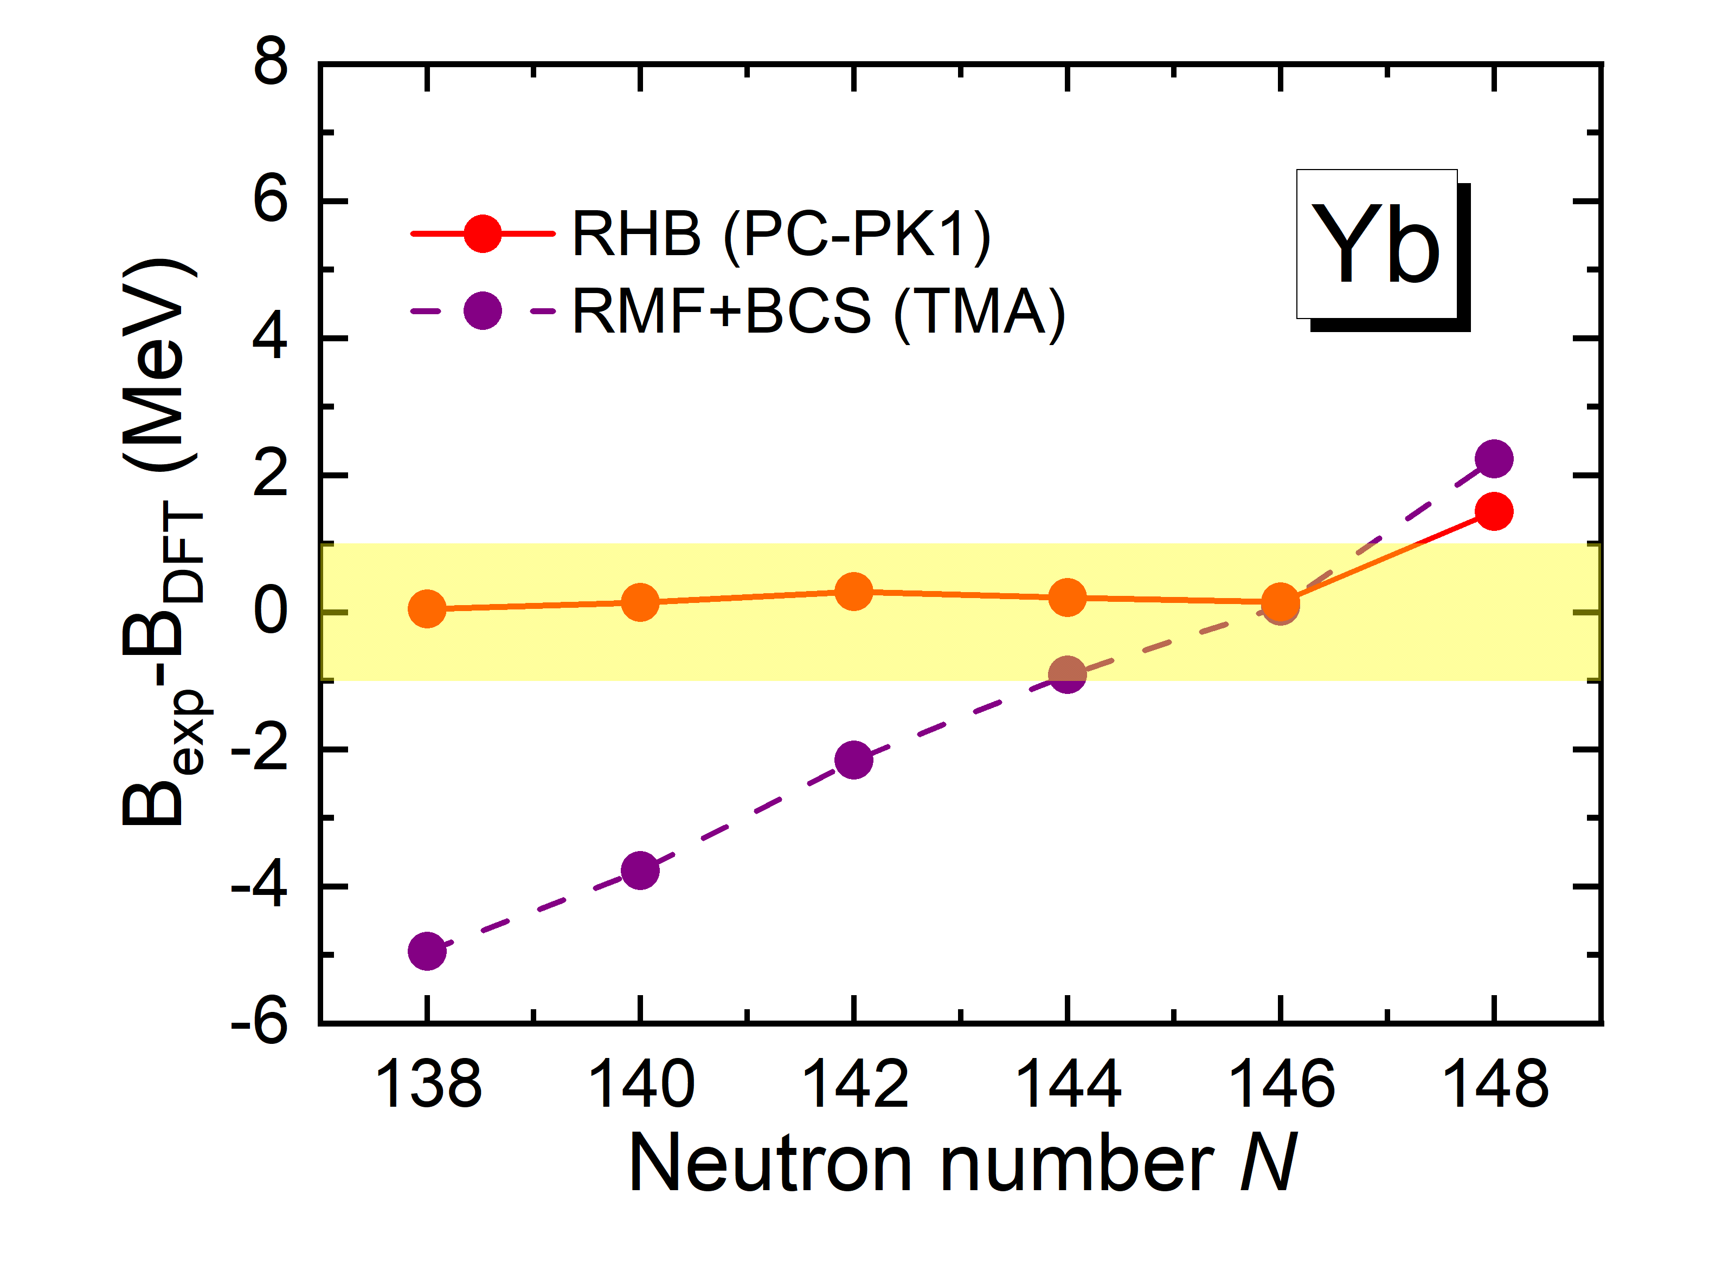
滴线
The proton drip lines similar, while the neutron ones quite different.
The neutron drip line by triaxial RHB with PC-PK1 is more extended.
In experimentally known regions, the isospin dependence of binding energies predicted by PC-PK1 are better.
P.W. Zhao et al., PRC82, 054319 (2010)
Notes:
这主要源于由于不同密度泛函的同位旋矢量性质不同。

Slide 25
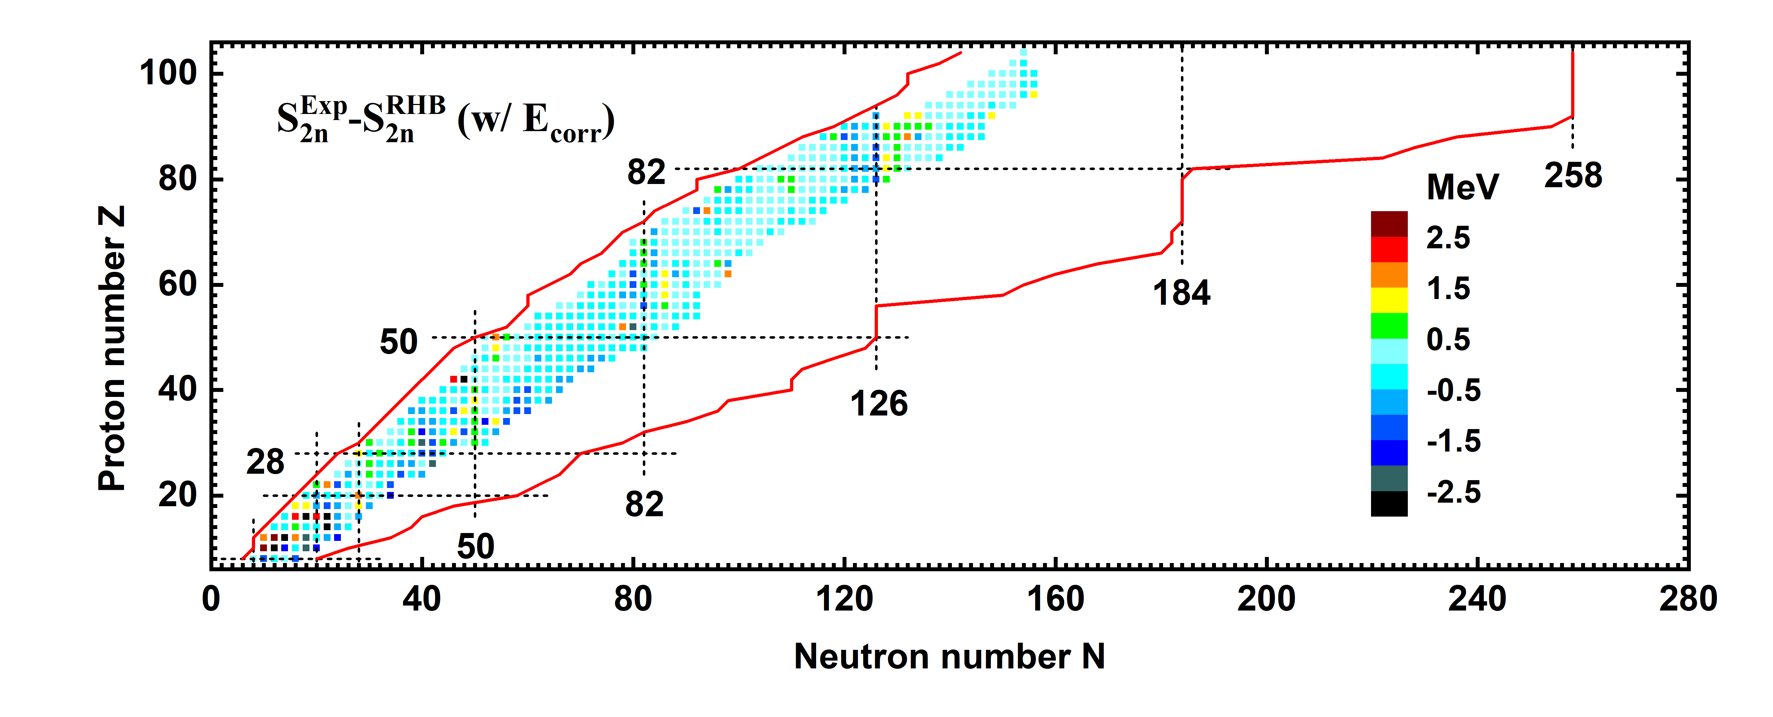
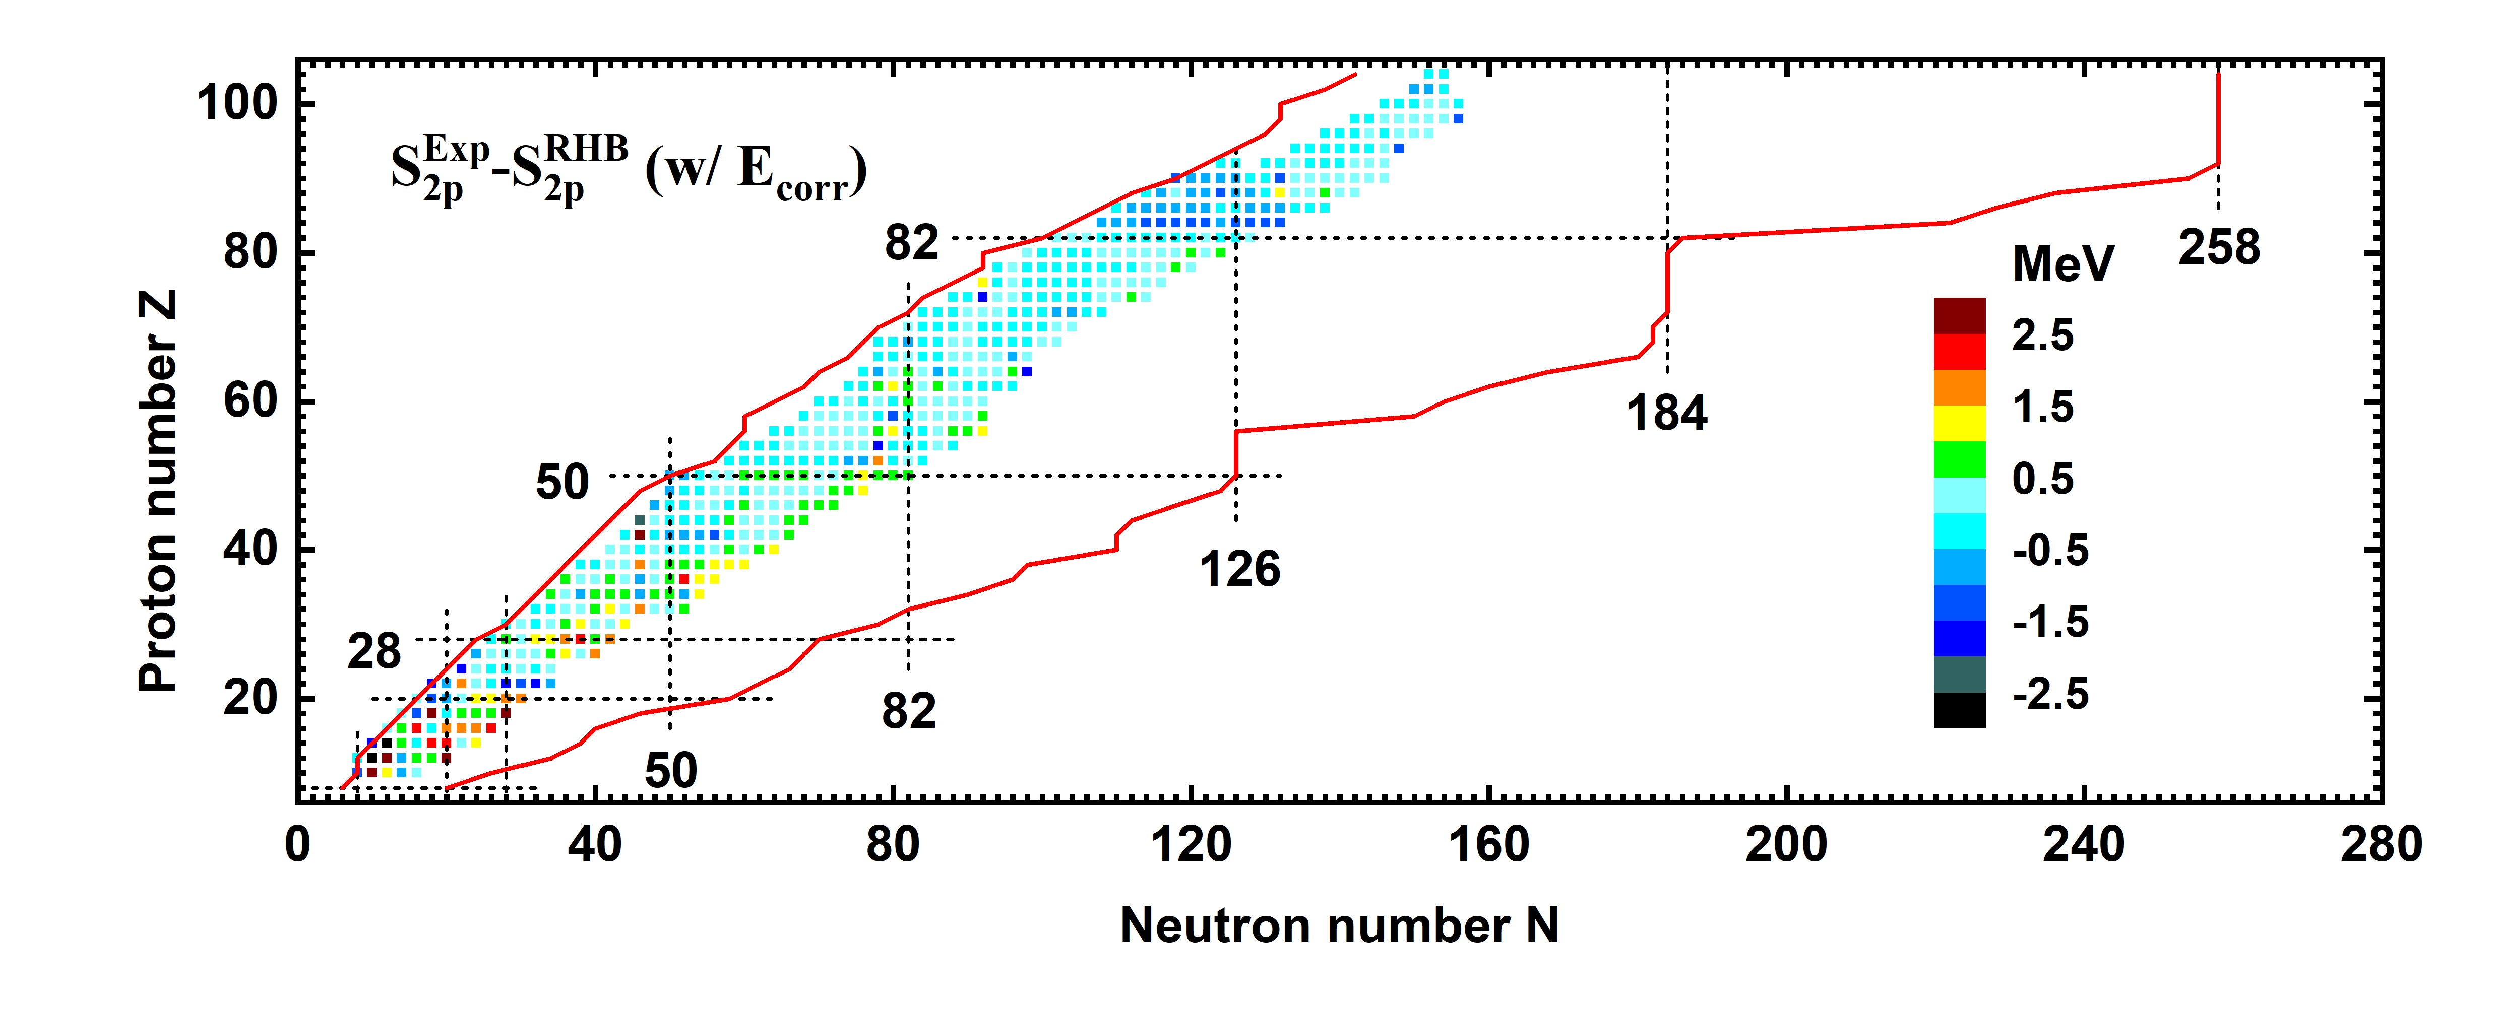
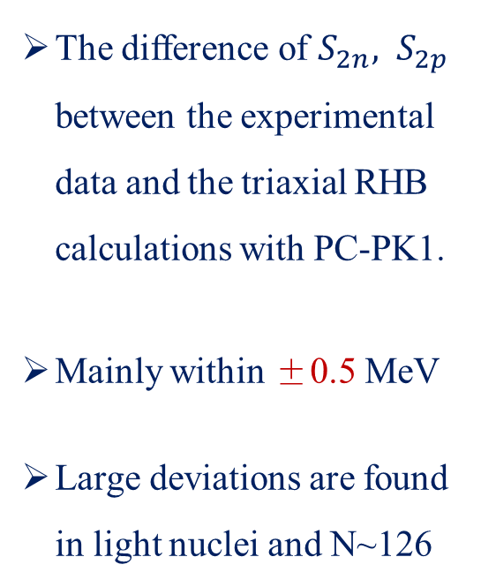
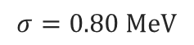
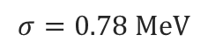
双核子分离能
The difference of $S_{2n}, S_{2p}$ between the experimental data and the triaxial RHB calculations with PC-PK1.
Mainly within ±0.5 MeV
Large deviations are found in light nuclei and N~126
$$σ=0.78 MeV$$
Experimental data from AME2016
$$σ=0.80 MeV$$

Slide 26
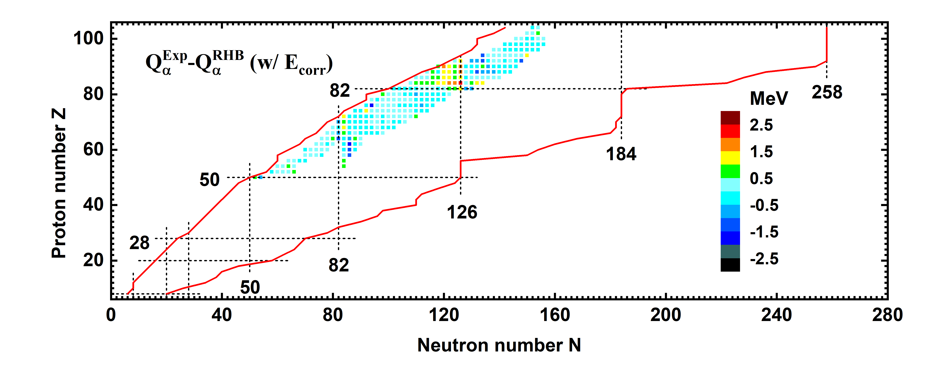
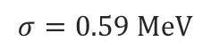
α 衰变能
$$σ=0.59 MeV$$
Very good except N~126; Modified for nuclei close to shells compared to DRHBc.
For too strong N=126 shell: 1. more constraint, e.g. s.p. levels;
2. more correlations, e.g. Fock, tensor

Slide 27
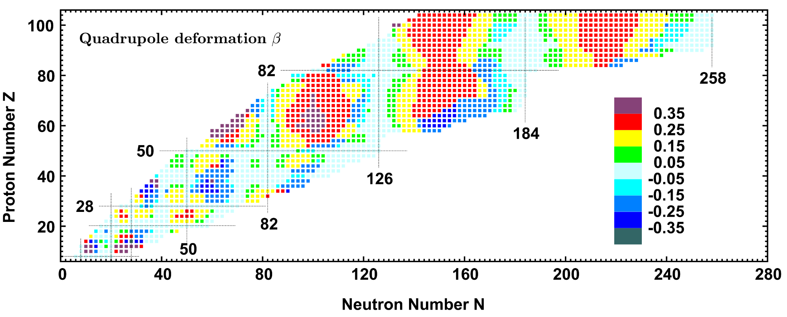
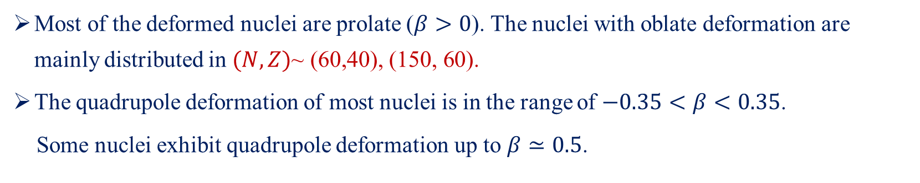
四极形变β
Most of the deformed nuclei are prolate ($β>0$). The nuclei with oblate deformation are mainly distributed in $(N,Z)\text{\sim }\text{(60,40), (150, 60).}$
The quadrupole deformation of most nuclei is in the range of $−0.35<β<0.35$.
Some nuclei exhibit quadrupole deformation up to $β≃0.5$.

Slide 28
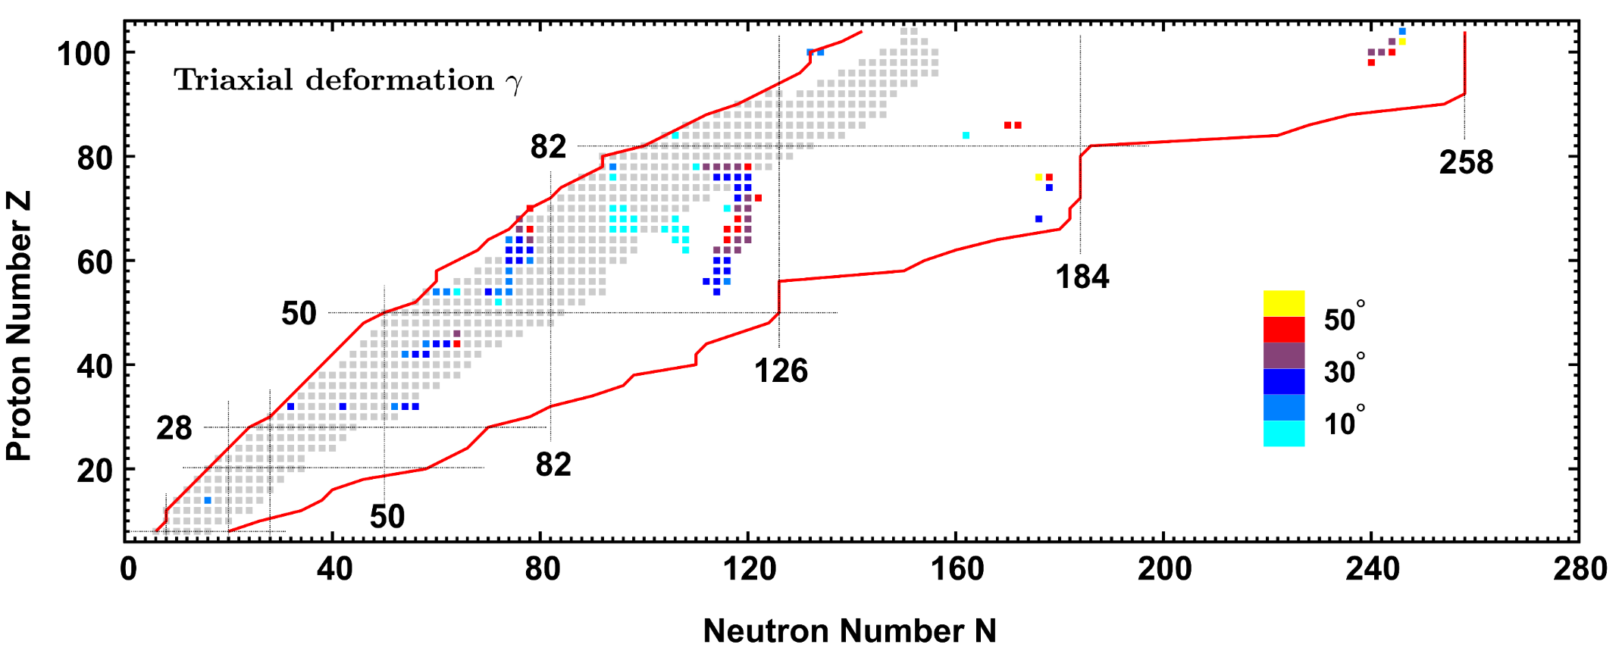
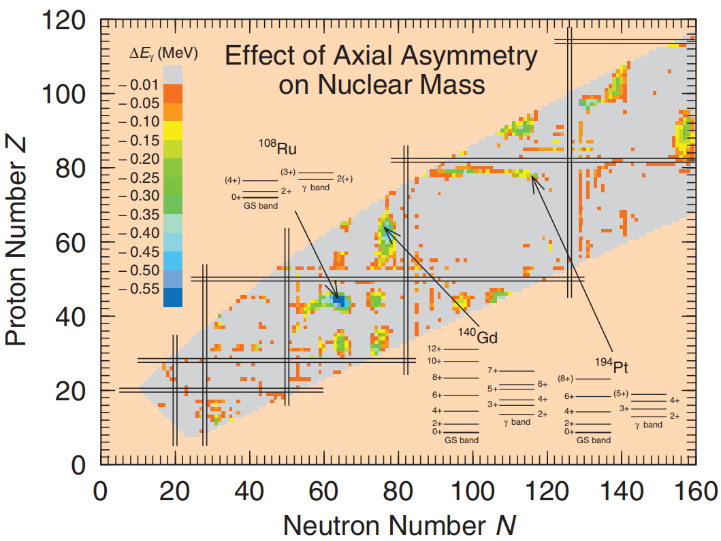
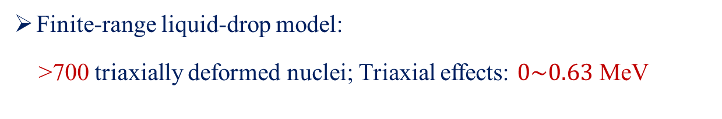
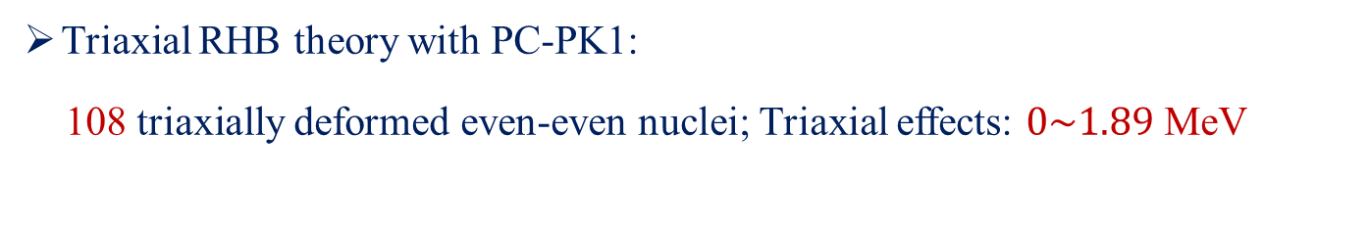
三轴形变γ
P. Möller et al., Phys. Rev. Lett. 97, 162502 (2006)
Triaxial RHB theory with PC-PK1:
108 triaxially deformed even-even nuclei; Triaxial effects: $0\sim 1.89$ MeV
Finite-range liquid-drop model:
>700 triaxially deformed nuclei; Triaxial effects: $0\sim 0.63$ MeV

Slide 29
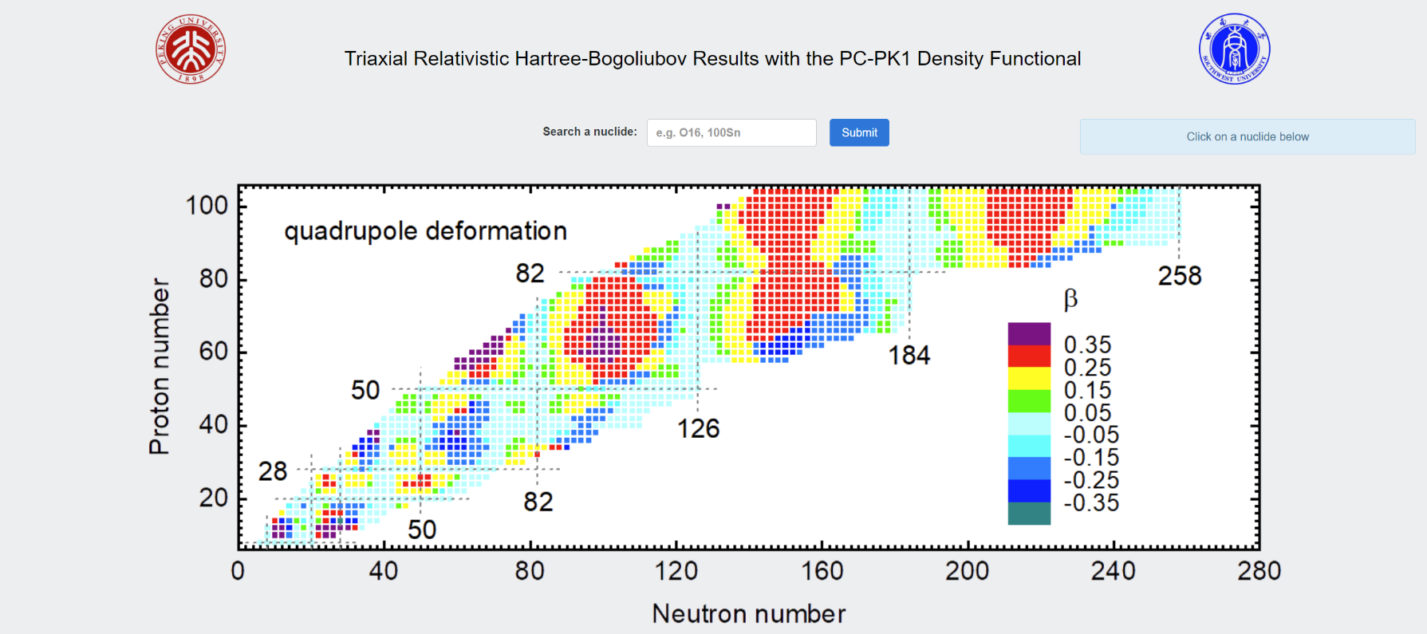
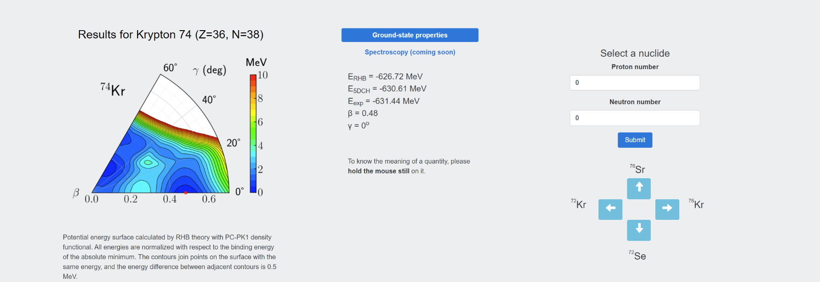
Online data base
http://nuclearmap.jcnp.org

Slide 30
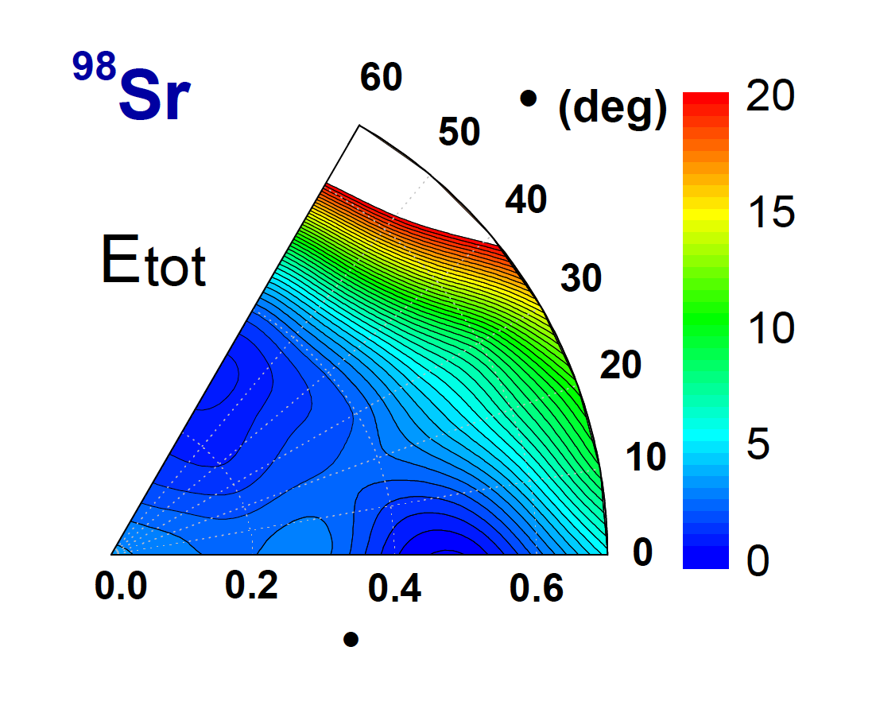
原子核形状共存
6₂⁺
𝛾
4₂⁺
2₂⁺
0₂⁺
6₁⁺
β
4₁⁺
2₁⁺
0₁⁺
Notes:
Here is one example for nuclear shape coexistence, the energies of the prolate and oblate minima are very close but rather separated in the beta-gamma plan with a triaxial barrier. Therefore, in the wells bands can be constructed, the band heads are very close but the deformations are very different.

Slide 31
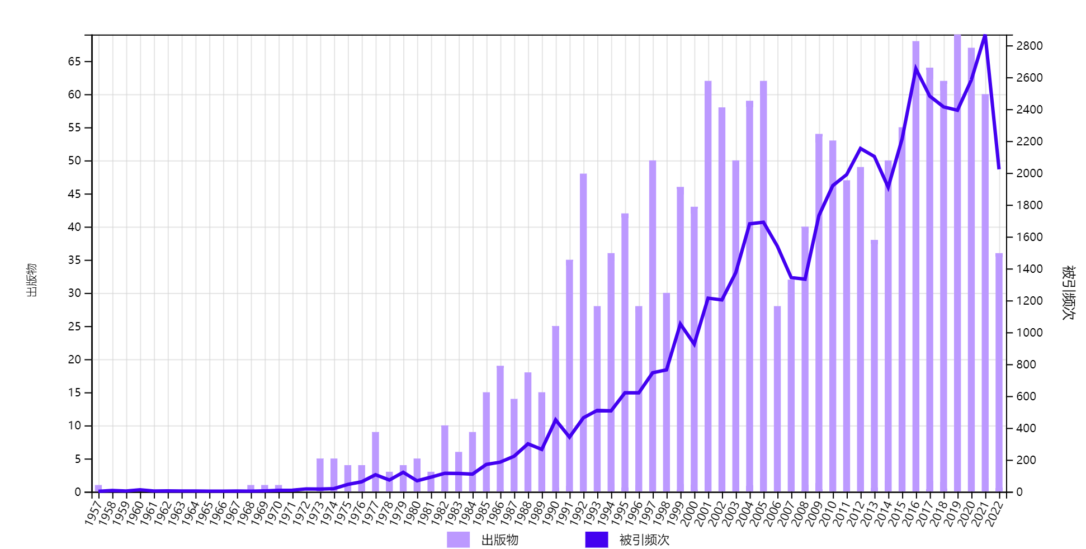
原子核形状共存
^{放射性核束装置}
¹⁶O的0⁺激发态可能具有形变
H. Morinaga, Phys. Rev. 101, 254 (1956).
Notes:
Here is one example for nuclear shape coexistence, the energies of the prolate and oblate minima are very close but rather separated in the beta-gamma plan with a triaxial barrier. Therefore, in the wells bands can be constructed, the band heads are very close but the deformations are very different.

Slide 32
四极集体激发与内禀形变
¹¹²Cd
0⁺ states have different shapes
Garrett et al., PRL 2019
Notes:
首先是原子核的四极集体激发与电四极跃迁。这里给出了微观集体哈密顿量模型计算得到的第一个2+，第二个和第三个0+态的激发能以及21+到基态的B（E2）跃迁强度，并于实验进行比较。整体而言理论与实验相符，尤其是B（E2）跃迁值，大部分核均落在对角线上。由此给我们足够的信心来提取可靠的原子核基态及激发态形变。这里我们采用四极形状不变量q2和q3来提取形变，它们在空间转动下保持不变，因而可以建立起约化跃迁强度与内禀形变a20、a22之间的关系。这里以Cd112核为例给出了01、02、03态的形变，并且发现三个0+态形状差异较大，为多重形状共存，与实验观测一致
Firstly, we show global calculations for the bound even-even nuclei using the triaxial CDFT with PC-PK1 functional. Upper and lower panels correspond to the results without and with the beyond-mean-field correlation energies, which are calculated by collective Hamiltonian model. Considering the BMF correlation energies, lowers the root-mean-square deviation for the binding energies significantly from 2.64 to 1.31 MeV, especially for the medium-heavy and heavy nuclei.
For the boundaries, the proton drip-lines are similar as those given by other functionals, but the neutron drip-line is extended dramatically.

Slide 33
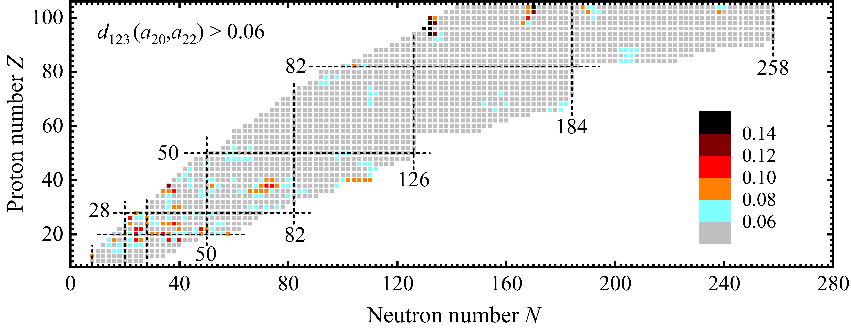
原子核多重形状共存
color：possible multiple SC
Garret, Zielinska & Clement, PPNP 2022
¹¹²Cd
Garrett et al., PRL 2019
Y.L. Yang et al., in preparation
Z~20, 28, 40, 50, 82 shell or sub-shell; transitional regions
Yang, Zhao & ZPLi, in preparation
Notes:
由此我们便对偶偶核进行了全局计算，具体计算结果汇总于该网站。找寻可能存在的多重形状共存，图中彩色点即为可能存在多重形状共存的核。主要出现在Z~20，28，40，50，82壳或者亚壳附近，尤其是Z~20和40附件的同位素链存在大量的多重形状共存。这里蓝色圆圈标记的区域为实验上已证实存在多重形状共存的核区。此外，我们还发现在一些过渡核区存在MSC，如这里，这里。。。
We have also calculated the low-energy spectra and transition rates. Here is one example for BE2 transitions. We can reproduce the experimental data very well. Based on the well described BE2, we could search for the possible regions of nuclear shape coexistence by checking the shape difference between the first and second 0^+ states.
The possible shape coexisting nuclei are shown by the colorful points. They are mainly located at the middle-shell or transitional regions. The regions in the blue circles are just consistent with the experimental data summarized in this review paper. And other regions are our predictions.

Slide 34
原子核多重形状共存
color：possible multiple SC
Garret, Zielinska & Clement, PPNP 2022
Yang et al., PRC(2021)
Y.L. Yang et al., in preparation
Z~20, 28, 40, 50, 82 shell or sub-shell; transitional regions
Yang, Zhao & ZPLi, in preparation
Notes:
这里是我们对丰中子的Er，Yb区域细致的研究结果，发现该核区存在扁椭、长椭以及大形变长椭共存的现象，详细讨论请参见六盘水厅下午场杨小芹的汇报

Slide 35
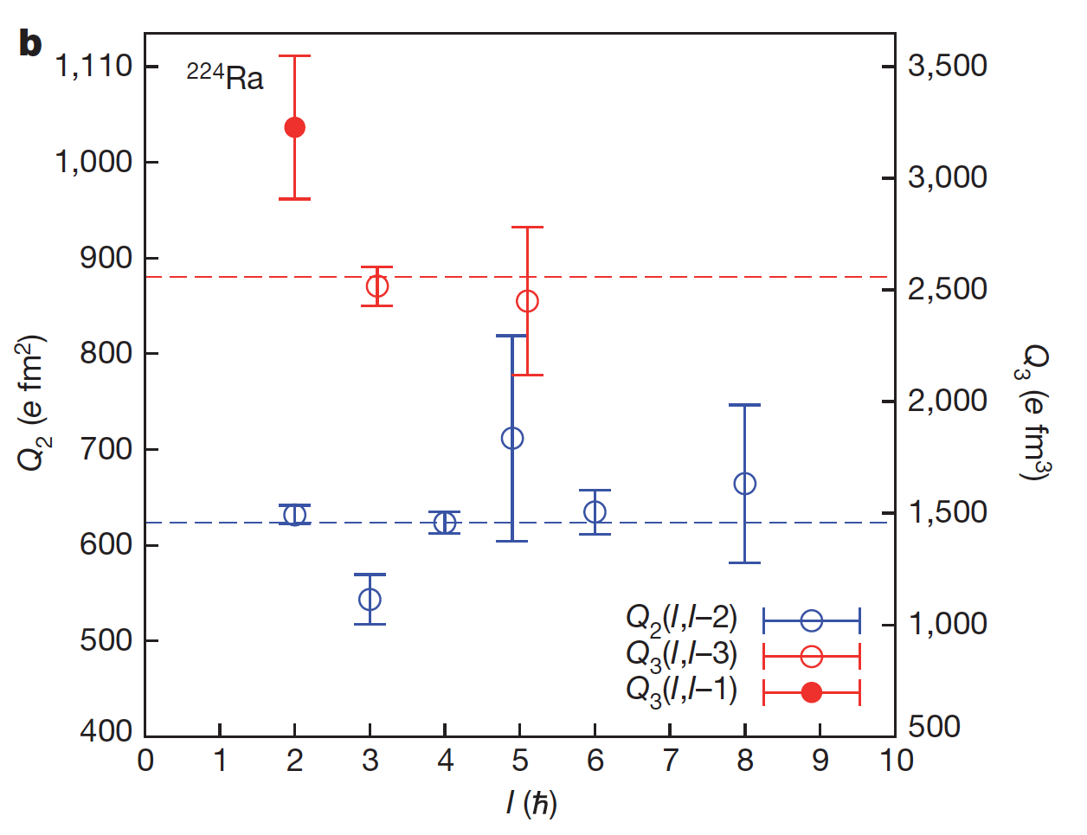
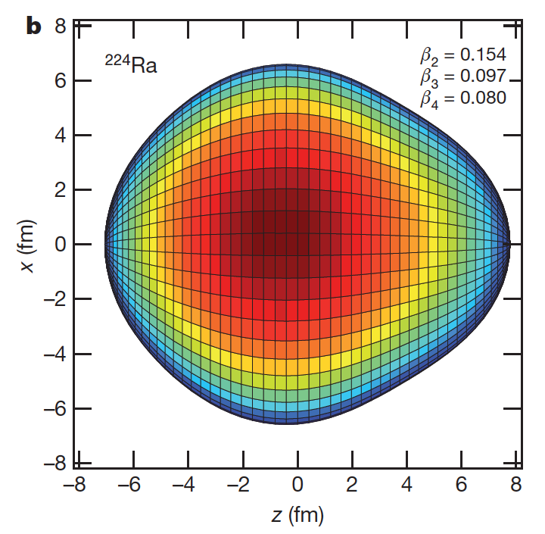
八极形变
²²⁴Ra is claimed to be a pear-shaped nucleus
L. P. Gaffney, et al., Nature 497, 199 (2013)
Direct evidence of octupole deformation in neutron-rich ¹⁴⁴Ba, ¹⁴⁶Ba
B. Bucher, et al., PRL116, 112503 (2016)
B. Bucher, et al., PRL118, 152504 (2017)
Notes:
Recently, Gaffney and coauthors have measured the quadrupole and octupole moments using the Coulomb excitation method. The results indicate that Ra224 is a pear-shaped nucleus. Like the shape in this figure. Very recently, direct evidence of … was also reported.

Slide 36
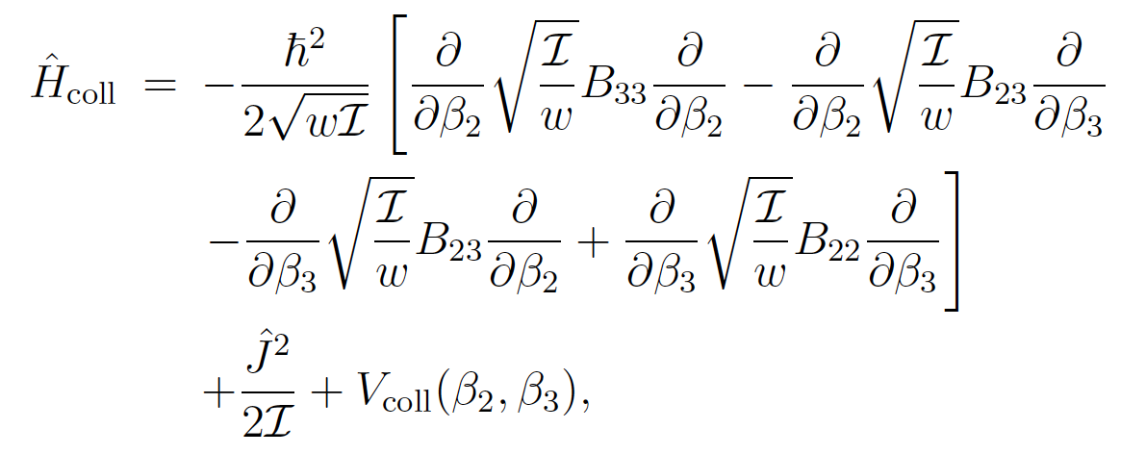
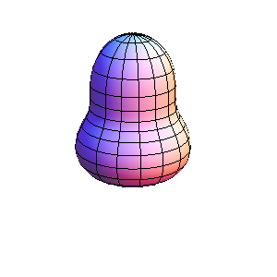
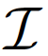
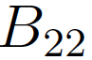
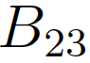
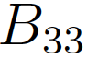
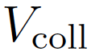
四极八极集体哈密顿量
The quadrupole-octupole collective Hamiltonian (QOCH)
小
𝜷₂
𝜷₃
大
Xia, Tao, Lu, ZPLi, Nikšić & Vretenar, PRC 96, 054303 (2017)
5 collective parameters (β₂, β₃):
Notes:
To describe low-lying negative-parity band, where the reflection asymmetric degree of freedom is necessary. Here, we construct the quadrupole-octupole collective Hamiltonian. the vibrational kinetic energy will be expressed as second order derivatives to beta2 and beta3. Here, we focus on axially symmetric system, and the rotational term has this simple form, where J is the angular momentum perpendicular to the symmetric axis. Vcoll is the collective potential.
Finally, the dynamics of the Hamiltonian is fully determined by the five collective parameters: MOI, 3 collective masses, and collective potential. They are functions of quadrupole and octupole deformation parameters beta2 and beta3.

Slide 37

八极形变
PES of ²²⁴Ra
Low-lying spectrum of ²²⁴Ra
Notes:
Here, we show the countour plots for the pes in the beta2, beta3 plane. A global minimum is found at beta2=0.18 and beta3=0.15, and more that 1 MeV deeper than the quadrupole saddle point.
Using these physical quantatities, we can construct the quadrupole and octupole collective Hamiltonian, and then the low-lying spectrum
We compare our theoretical results with experimental data for both positive- and negative-parity states. The agreement is very good for both excitation energies and electric transition strengths, especially considering that our model contains full configurations and no any effective charge is included. It is remarkable that the low-lying 1-, 3- states, alternating-parity band, and large E3 transitions are all reproduced well. Combined with the PES, we further confirmed the conclusion of the expiremental measurement. Namely, Ra224 is a stable octupole deformed nucleus.

Slide 38


八极形变
Ra, Th, U, Pu (N=130~152)
近球形→八极→八极软→四极
最大B(E3)在N~136
Notes:
我们还可以分析原子核八极形变及电偶电八极跃迁，这里给出了偶偶Ra、Th、U、Pu的四极-八极位能曲面及3-到基态0+的B（E3）随同位素链的演化规律，位能面比较相似，这里以Ra链为例。结合位能面和E3，发现在该区域展现出从近球形至稳定八极，再到八极软，最后至稳定四极形变的演化规律。最大的BE3出现在中子数136附近，此时八极形变最强。

Slide 39

八极形变
B(E3;3⁻ → 0⁺)
Notes:
系统研究了Xe, Ba稀土区，及Rn，Ra，锕系区。这里给出了理论计算的3-到基态的约化电八极跃迁几率，大的B(E3)指示原子核存在八极形变。对于Xe, Ba稀土区，我们发现Ba，Ce同位素链在N=90-96具有八极形变，而Nd、Sm、Gd在这片区域均具有较强的八极关联。Ra及锕系核则在N=134-140形成明显的八极形变，对于N=142-146，结合势能曲面，发现这些核主要为八极软核。

Slide 40

核裂变：¹⁸⁰Hg新型不对称裂变
“双幻”
低能裂变实验测量，截至2016
⁹⁰Zr
⁹⁰Zr
理论上
¹⁸⁰Hg
实验观测
Andreyev, Nishio & Schmidt, Rep. Prog. Phys. (2018)
Andreyev et al., PRL (2010)
Notes:
得益于放射性核束装置的发展以及探测设备的升级，近年来人们在低能核裂变方面开展了大量的测量工作，取得了很多突破性进展，这里汇总了截至2016年的测量核区及激发方式。其中在缺中子Pb区的新型非对称裂变吸引了众多关注，如180Hg，80个质子100个中子，理论上应该主要裂变为两个双幻核90Zr，应以对称裂变为主。但实际观测到的却是非对称裂变模式为主，其中重碎片峰值在Ru100附近。
Fission plays an important role in the r process, particularly within the NS-NS merger. Fission determines the region of the nuclear chart at which the flow of neutron captures and beta decays stops.
Based on constraint CDFT, we can calculate potential energy surface for fission in a large-scale quadrupole-octupole deformation space. Here take Th226 as an example. Obviously, we can see the fission valleys, and scission line clearly.
Then we can simulate fission of nuclei by the evolution of a wave package on this PES. The wave packet starts from the equilibrium state and move fast to the large deformation regions along the fission valleys. Then we can collect the probabilities on the boundary to obtain the fission fragment distributions.

Slide 41
实验进展
用途广泛的核物理
Excitation energy dependence of fragmentmass distributions from fission of ^{180,190}Hg formed in fusion reactions of ³⁶Ar + ^{144,154}Sm
K. Nishio et al. PLB 748, 89 (2015).
Observation of mass-asymmetric fission of mercury nuclei in heavy ion fusion,
E. Prasad et al. PRC 91, 064605 (2015).
Fission fragment mass distribution in the ³²S+¹⁴⁴Sm reaction
T. N. Nag et al. PRC 103, 034612 (2021).
Asymmetric and symmetric fission of excited nuclei …
A. A. Bogachev et al. PRC 104, 024623 (2021).
A. A. Bogachev et al. PRC 104, 024623 (2021).
……
Notes:
实验上，一系列通过不同手段探索Hg区裂变的实验陆续开展，而其结果说明了即使激发能高达30至40MeV，非对称裂变模式依然起着重要作用，

Slide 42





含时动力学方程
含时类薛定谔方程
集体流
裂变产物分布
Tao, Zhao, ZPLi, Nikšić, Vretenar, PRC 96, 024319 (2017)
Notes:
To describe low-lying negative-parity band, where the reflection asymmetric degree of freedom is necessary. Here, we construct the quadrupole-octupole collective Hamiltonian. the vibrational kinetic energy will be expressed as second order derivatives to beta2 and beta3. Here, we focus on axially symmetric system, and the rotational term has this simple form, where J is the angular momentum perpendicular to the symmetric axis. Vcoll is the collective potential.
Finally, the dynamics of the Hamiltonian is fully determined by the five collective parameters: MOI, 3 collective masses, and collective potential. They are functions of quadrupole and octupole deformation parameters beta2 and beta3.

Slide 43










¹⁸⁰Hg裂变研究 — PES
$$(4.06, 2.08)$$
$$−1399.2696 MeV$$
$$({}_{}^{101}{Rh}/{}_{}^{79}{Br})$$
$$(4.54, 0.00)$$
$$−1396.9333 MeV$$
$$({}_{}^{90}{Zr}/{}_{}^{90}{Zr})$$
$$(0.98, 0.00)$$
$$(0.02, 0.08)$$
$$−1411.43899 MeV$$
在剪裂线附近对$q_{N }$进行约束计算，断点定义为裂变谷与聚变谷间的鞍点
ZY Li, SY Chen, YJ Chen, ZP Li. PRC 106,024307(2022)
Notes:
基于上述理论我们得到了180Hg维势能面。….为四极形变方向，…..为八极形变方向，洋红色实现表示静态裂变路径，酒红色点线表示剪裂线。我们在剪裂线附近对其进行了脖子处数约束，并且定义裂变谷与聚变谷间的鞍点作为断点，这可以从图c中可以明显的看出。
沿着静态裂变路径，原子核在(beta2,beta3)=(0.98,0)位置处向反射不对称方向弯曲，之后一直拉伸至(beta2, beta3) ~ (4.08, 2.08) 位置处发生断裂，产生轻重碎片分别为101Rh和79Br，此处势能为-1399.2696MeV，较基态位置大约高出12MeV；沿着对称裂变路径走，在(2.60,0.60)至(4.50,0.00)位置处存在一个对称裂变谷，并在(4.54,0.00)处发生断裂，此处能量为-1396.9333MeV，比非对称裂变点能量高出2.3MeV。此外，我们在图b中发现了对称型紧凑裂变模式，如紫色虚线。
这将导致180Hg将以非对称裂变为主。
为更好的描述非对称裂变道的碎片质量几率最大的原因，我们对剪裂线的物理量做了详细的分析。

Slide 44




¹⁸⁰Hg裂变研究 — 剪裂组态
八极“幻数”
费米面
¹⁰⁰Ru中子单粒子能级图
Notes:
为描述剪裂组态的信息，我们将剪裂线的一些物理量随beta3的变化做了输出，(a)~(d)分别表示势能、重碎片质量数、碎片beta2、beta3形变随原子核整体beta3的变化，我们可以发现在beta3从0到1.5左右势能缓慢的上升，之后从1.5到2.1左右开始有一个快速的下降。从势能最低点区域可以发现其对应的重碎片质量在96~106左右，这刚好对应到最有可能的实验观测量。
为理解其变化原因，我们将最可能的偶偶核裂变碎片100Ru的势能面及其单粒子能级随原子核形状拉伸的图像描绘了出来。在100Ru势能面中，紫色星号表示裂变过程中能量最低出最对应的形变点，它恰好位于球形极小（0.2，0.0）和（0.4，0.5）间的浅谷之间，而这可能拉低整个系统的结合能。此外，我们发现这个浅谷是由N=56的八极壳间隙驱动形成的，即所谓的”八极幻数“，认为这是导致非对称裂变道能量比对称裂变道能量更低的微观机制。

Slide 45



¹⁸⁰Hg裂变研究 — 总动能与产物分布
沿剪裂线的碎片总动能分布整体趋势与实验一致
裂变碎片分布于实验数据符合较好
$Z_{H,L}$ —— 重/轻碎片电荷
$d_{ch}$ —— 碎片质心距离
总动能与碎片质量分布实验值
J. Elseviers, et al. Phys.Rev. C 102, 019908 (2020)
碎片质量分布 BSM(M)
P. Moller, et al. Phys.Rev. C 85,024306(2012)
Notes:
我们在这里展示了 180Hg 的裂变动力学结果以及相应的总动能分布。
左图我们展示了碎片的总动能分布。目前我们计算总动能所用的公式比较简单，但整体上实现了实验观测量的趋势。
右图展示了碎片质量分布，我们与现有的理论和实验值做了对比。计算结果整体复现了实验趋势，特别是复现了非对称裂变峰的位置，其对应元素为101Rh（铑）和79Br（溴）。而其他理论如 BSM(Brownian Shape Motion)， 非对称峰峰位相差了约4个核子
此外，我们预测了 AH=116 的非对称裂变峰峰位

Slide 46

Summary and outlook
We have developed the CDFT-based models:
5DCH
low-lying spectrum;
Shape coexistence, et. al.
Core
CQC
Spectrum of odd-A nuclei;
Shape (phase) transition
Collective Hamiltonion based on CDFT
Core
QOCH
Low-lying $π=−$ bands;
Octupole deformation; parity doublet
TDGCM+GOA
Nuclear fission dynamics
Notes:
Here is a brief summary, that we have …

Slide 47
Summary and outlook
Application to the interesting topics
Systematic study of nuclear shape coexistence; new regions of SC
Octupole deformation and negative parity band
New type asymmetric fission in sub-lead region
Outlook:
SC in odd-A nuclei
Odd-A octupole deformed nuclei
Dynamics of angular momentum of fragments
Notes:
Here is a brief summary, that we have …

Slide 48
Thank you for your attention!
J. Meng & PKU group Peking University
T. Niksic & D. Vretenar University of Zagreb
Y. J. Chen CIAE
Z. M. Niu Anhui University
J. Xiang Qiannan Normal University
J. Zhao China Academy of Engineering Physics
Nuclear Physics Group in SWU

